Slide 2
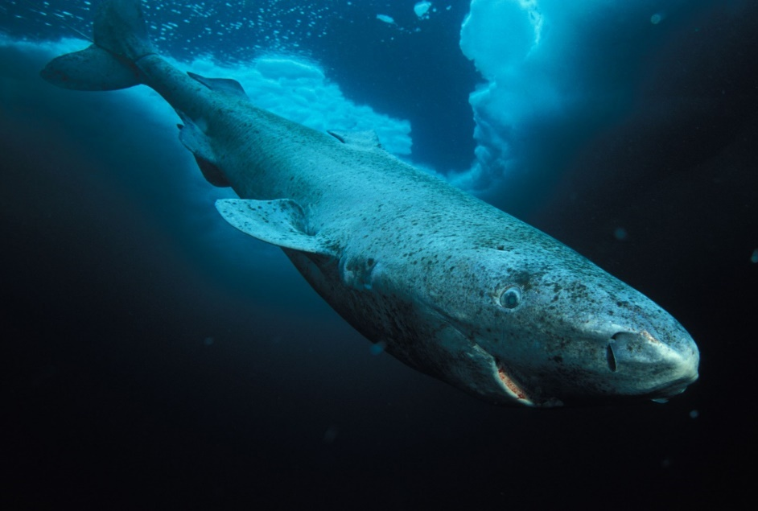
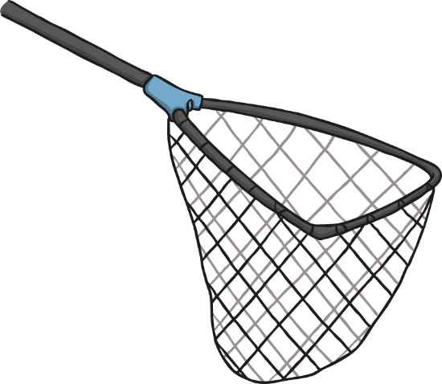
400-Year-Old Sharks
Scientists have discovered a female Greenland shark that lived to be approximately 400 years old.
Scientists can not be sure of the shark’s exact age; they think it was at least 272 but it could have been as old as 512.
The scientists looked at 28 sharks, most of which had died after being caught by mistake in fishing nets.
greenland-shark-1920x1080-hudson-bay-labrador-diving-tourism-blue-sea-1208_26470701957_o by Edward Lim is licensed under CC BY 2.0

Slide 3

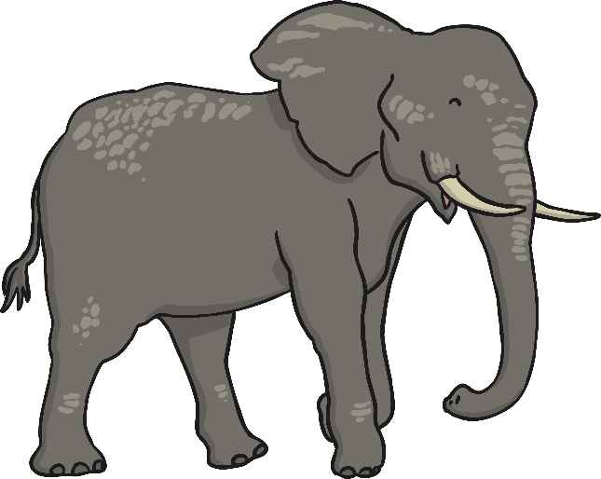
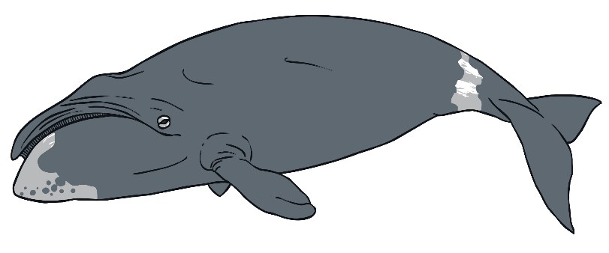
Growing Old
Some animals can live for a very long time.
Elephants in captivity can live to be over 80 years old.
The oldest human lived to be 122
years old.
Bowhead whales can live to be over 200 years old

Slide 4
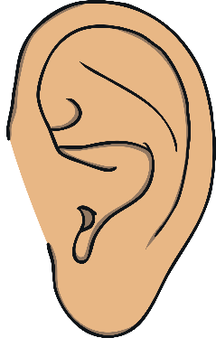
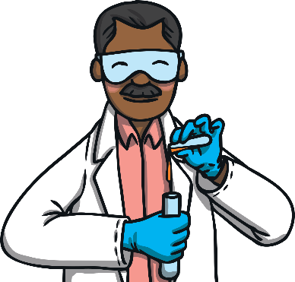
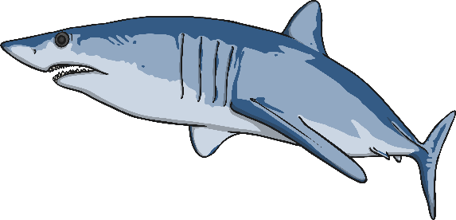
Estimating Age
It is very difficult to estimate or measure the age of a Greenland shark.
Scientists can calculate the ages of many fish by counting the growth layers of calcium carbonate ‘stones’ found in their ears but sharks do not have ear stones.
Scientists looked at the lenses of the eyes of Greenland sharks to work out their age.
The lenses are made of proteins and by working out the age of these proteins it is possible estimate the shark’s age.

Slide 5
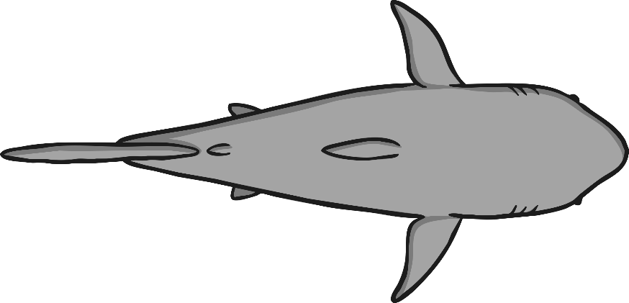
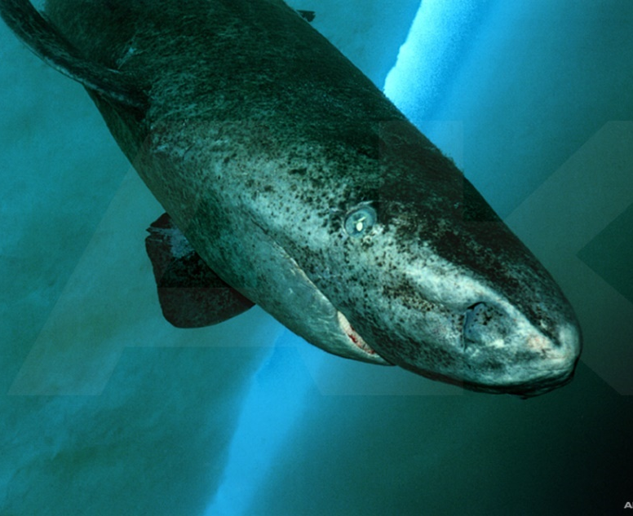
Greenland Sharks
Greenland sharks grow to lengths of around five metres.
The Greenland shark is one of the world’s largest carnivores.
Scientists think that Greenland sharks would have to be around 150 years old before they could reproduce.
5 metres
Diving with Greenland Shark by Arctickingdom.com is licensed under CC BY 2.0

Slide 6
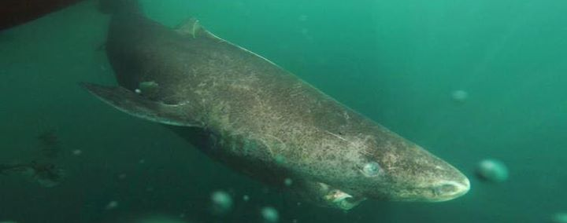
Greenland Sharks
Greenland sharks develop very slowly, growing by only 1cm per year.
They are also known sleeper sharks because of their very slow movements.
They are the longest-living vertebrate species on the planet.
Greenland Shark - Somniosus microcephalus by andyaj58 AJ is licensed under CC BY 2.0

Slide 7

The Science of Sharks
The discovery of the shark’s age will help scientists make calculations about the shark population.
Scientists hope to study the Greenland shark’s
cells to see what makes them live for so long.
This knowledge could help with understanding illnesses and aging in humans.

