Slide 1
Addition and Subtraction in KS1

Slide 2
Transition
Continuation of strategies used in Reception/Foundation Stage
Practical activities
Concrete resources
Real Life situations
KEY Resources
Creating a Maths Toolbox- What will help me?
Language associated with adding and subtraction
5 + 4 =
8
2
7
9
3
4
6
1
5

Slide 3

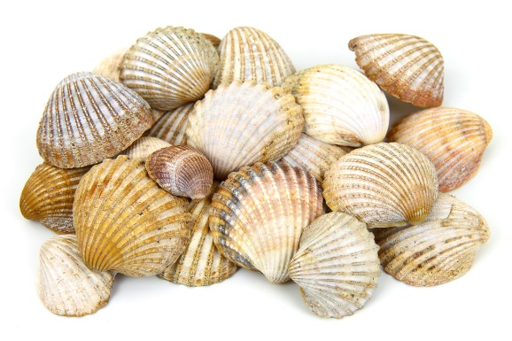
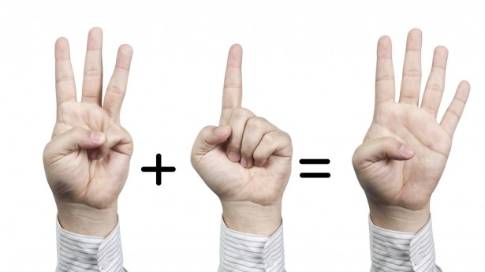
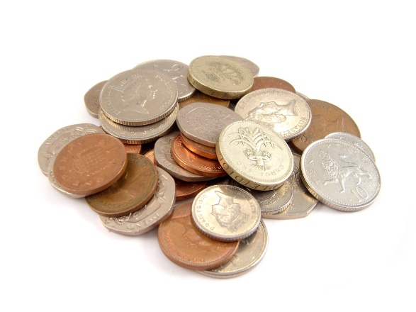
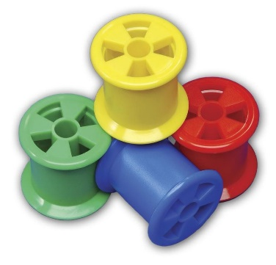


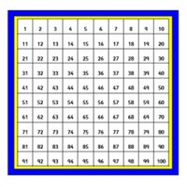
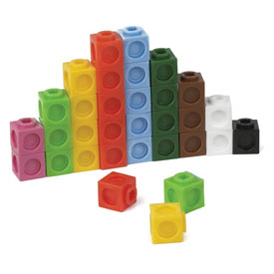
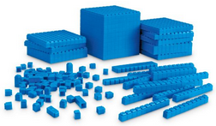
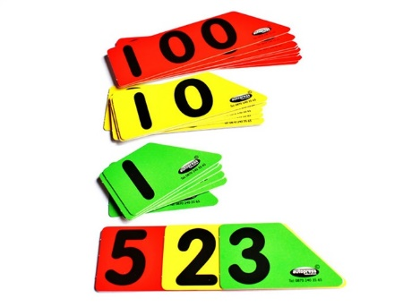
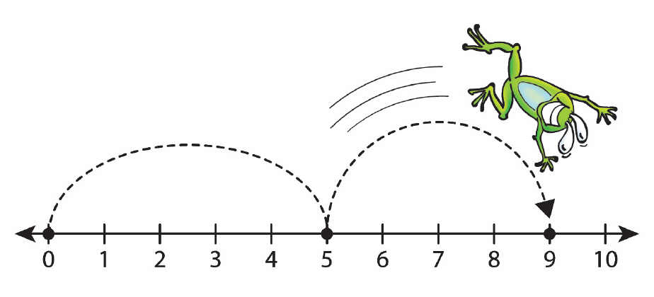
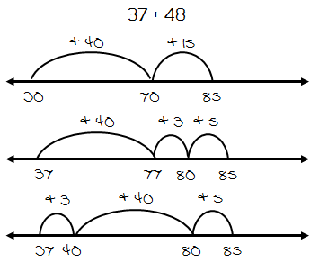
Maths Toolbox
Use real life objects?
Use your fingers?
Maybe draw a picture?
Will apparatus help?
Will a number line help?

Slide 4
Subtraction
Children need to understand the concept of subtraction, that it is:
Removal of an amount from a larger group (take away)
Comparison of two amounts (difference)
They also need to understand and work with certain principles:
Inverse of addition
Not commutative i.e. 5 - 3 ≠ 3 - 5

Slide 5
Addition
Children need to understand the concept of addition, that it is:
Combining two or more groups to give a total or sum
Increasing an amount
They also need to understand and work with certain principles:
Inverse of subtraction
Commutative i.e. 5 + 3 = 3 + 5
AN UNDERSTANDING OF PLACE VALUE

Slide 6
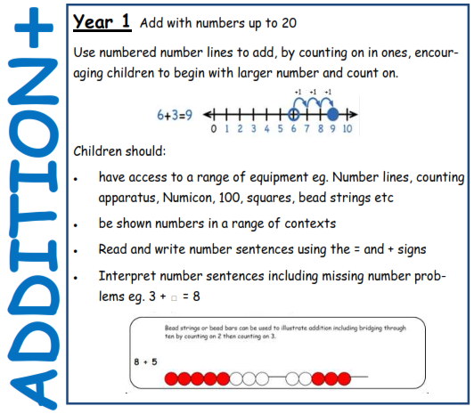

Slide 7
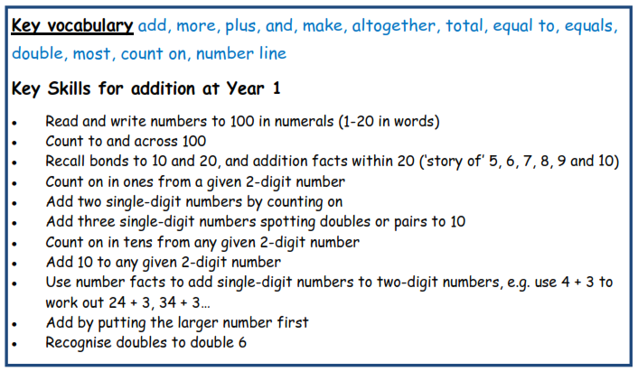

Slide 8
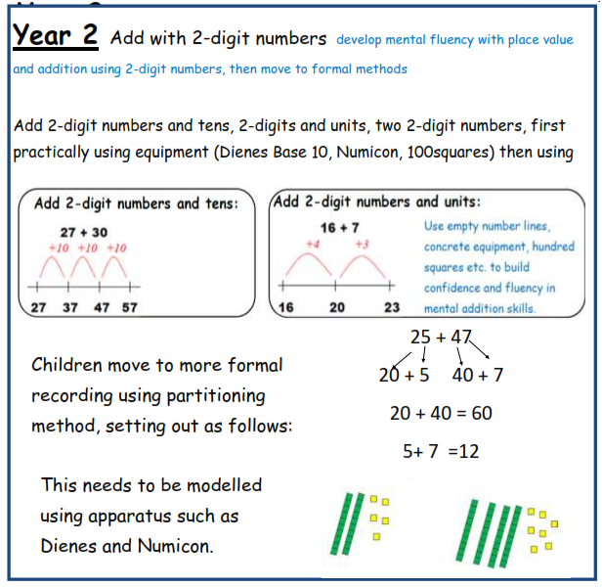


Slide 9
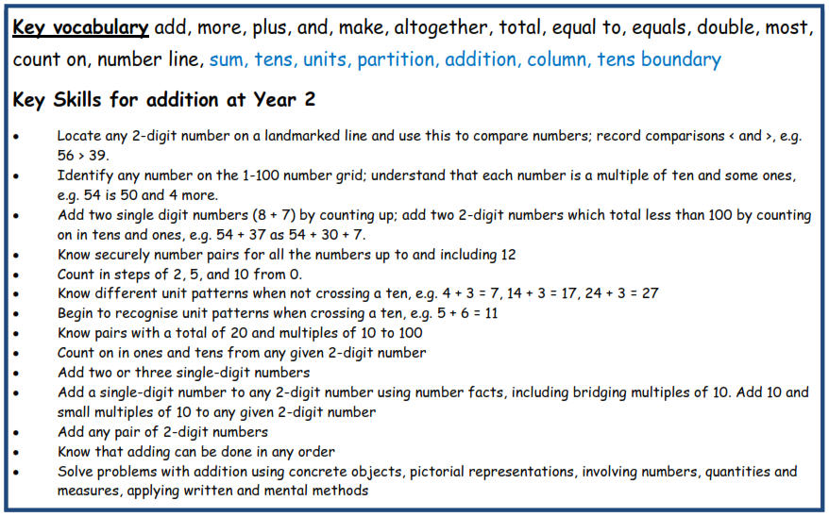

Slide 10
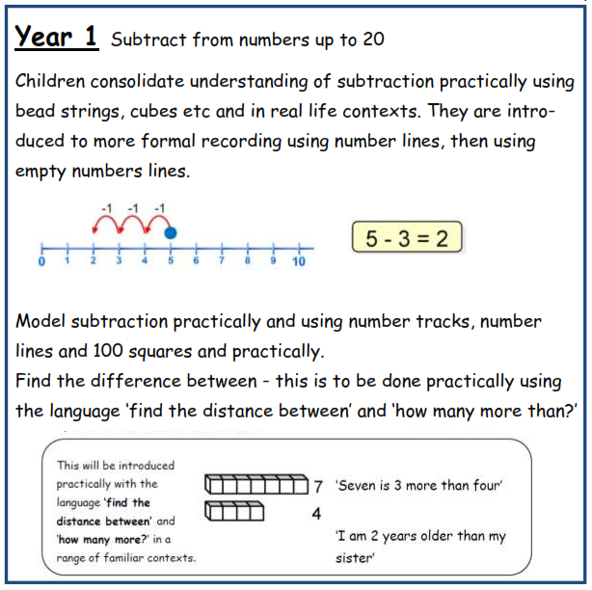


Slide 11
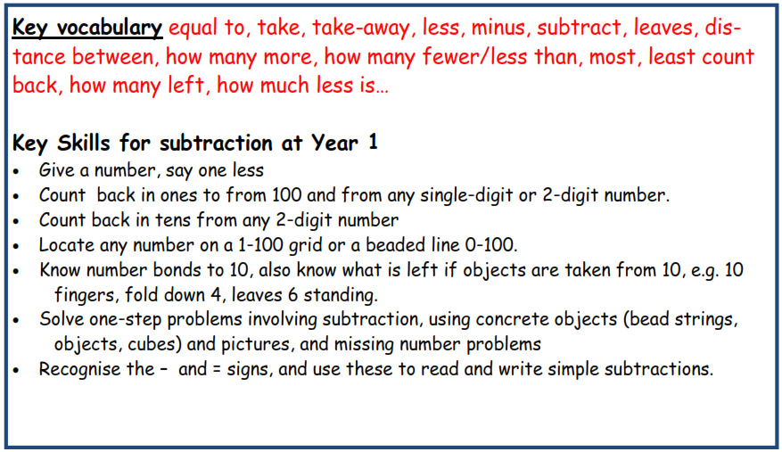

Slide 12
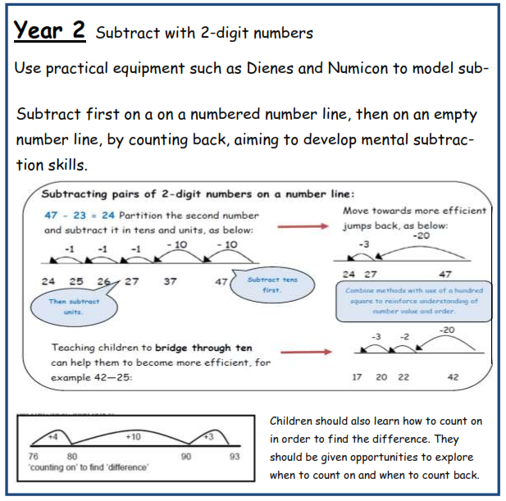

Slide 13
