Slide 1
Multiplication in Year 1
Count in tens.
Recall and use multiplication facts for 10 and x tables.
Count in twos - recognise odd/even numbers.
Recall and use multiplication facts for 2 x tables.
Count in fives.
Recall and use multiplication facts for the 5x table.
Know that multiplication can be done in any order (commutative).
using concrete objects, pictorial representations and arrays with the support of the teacher

Slide 2
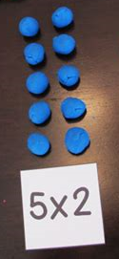
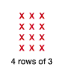

Multiplication & in Year 1
Concrete – Pictorial - Abstract

Slide 3
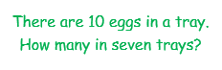
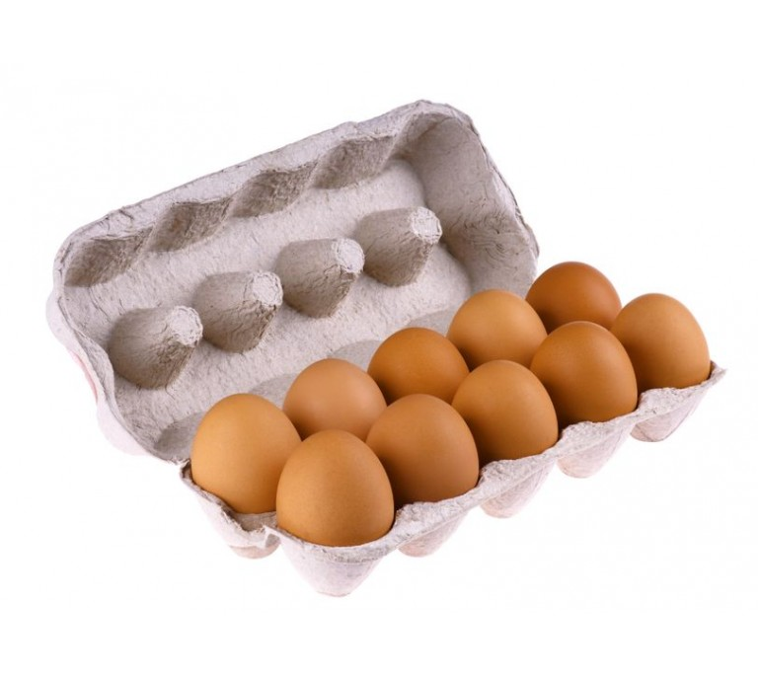
Multiplication Problem Solving
Clare is working out 19 – 12 = She begins building both numbers with base 10. Explain why she doesn’t need to do this.

Slide 4
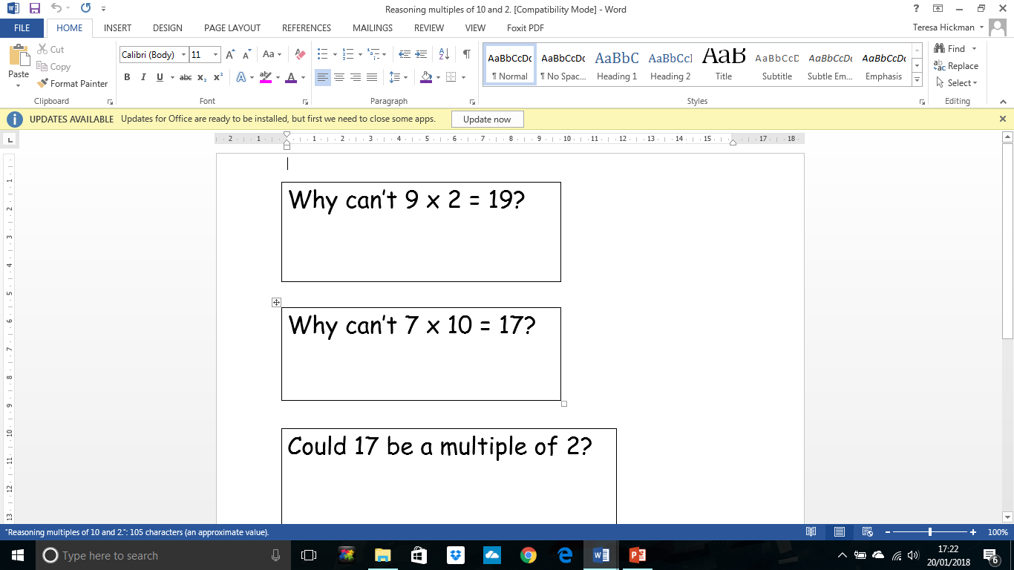
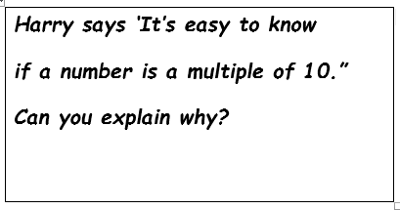
Reasoning
Clare is working out 19 – 12 = She begins building both numbers with base 10. Explain why she doesn’t need to do this.

Slide 5
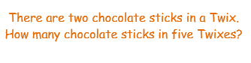

Multiplication Problem Solving
Clare is working out 19 – 12 = She begins building both numbers with base 10. Explain why she doesn’t need to do this.

Slide 6
Reasoning
Clare is working out 19 – 12 = She begins building both numbers with base 10. Explain why she doesn’t need to do this.

Slide 7
Division in Year 1
Derive division facts for the 10 x tables.
Derive division facts for the 2 x tables.
Solve word problems.
Understand that division cannot be done in any order.
Derive division facts for the 5 x tables.

Slide 8
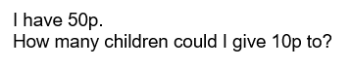
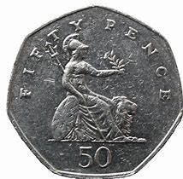
Division Problem Solving
Clare is working out 19 – 12 = She begins building both numbers with base 10. Explain why she doesn’t need to do this.

Slide 9

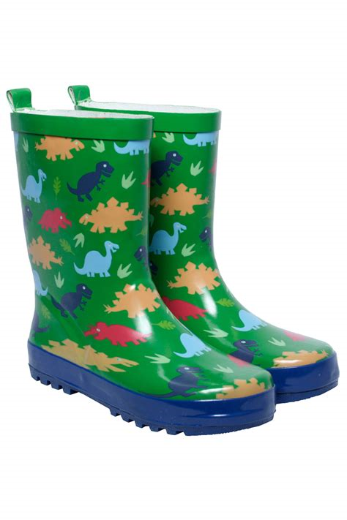
Division Problem Solving
Clare is working out 19 – 12 = She begins building both numbers with base 10. Explain why she doesn’t need to do this.

Slide 10
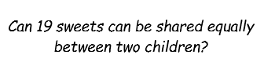
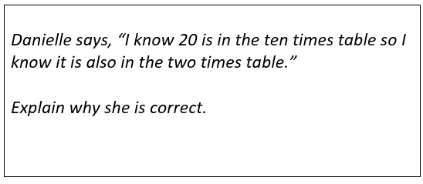
Reasoning
Clare is working out 19 – 12 = She begins building both numbers with base 10. Explain why she doesn’t need to do this.

Slide 11
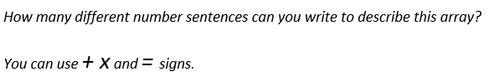

MASTERY
Clare is working out 19 – 12 = She begins building both numbers with base 10. Explain why she doesn’t need to do this.

Slide 12
Multiplication in Year 2
Recall and use multiplication facts for the 10, 2 and 5x table mentally.
Know that multiplication can be done in any order (commutative).
Solve problems in a range of contexts including quantities, money and measures.

Slide 13
Division in Year 2
Recall division facts for the 10 x, 2x and 5x tables.
Understand that division cannot be done in any order.
Solve word problems involving division in a range of contexts; quantities, money and measures.

Slide 14
Multiplication and Division in Year 2 Greater Depth
Count in multiples of 3.
Recall facts for the 3 x table.
Count in multiples of 4.
Recall facts for the 4 x table.

Slide 15
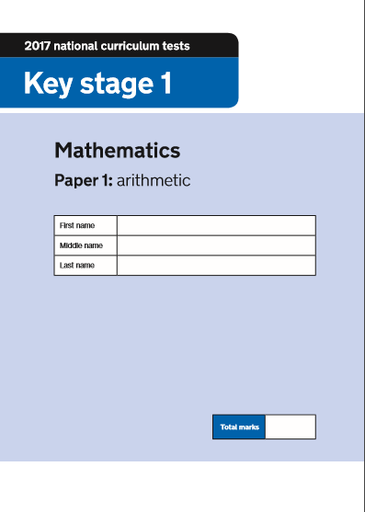

Year 2 SATs – May 2018

Slide 16
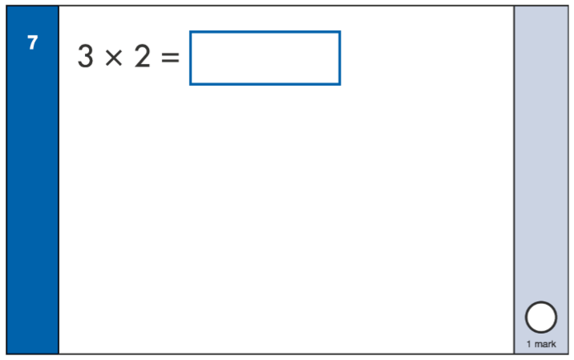
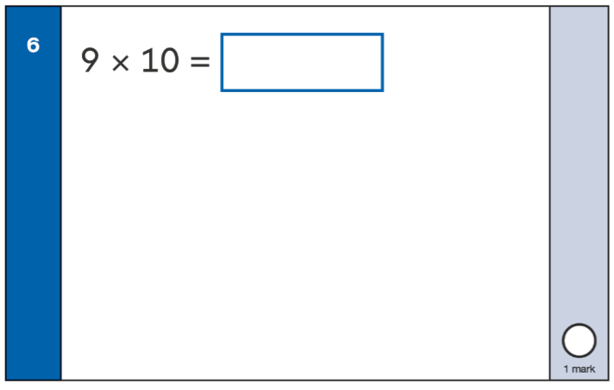
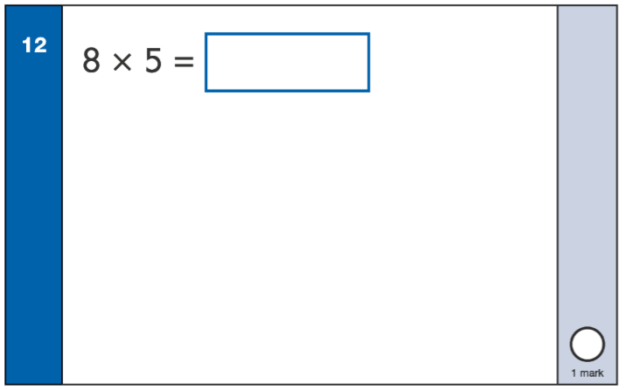
Multiplication SATs Questions – Arithmetic Paper

Slide 17
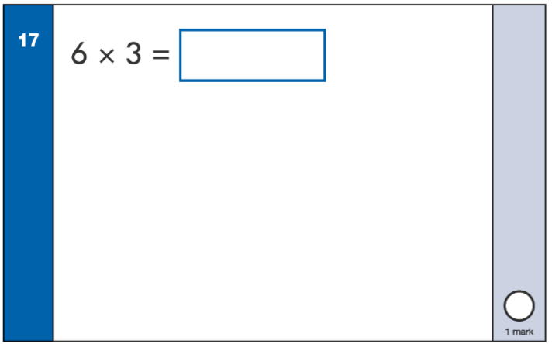
Multiplication SATs Questions – Arithmetic Paper Greater Depth

Slide 18
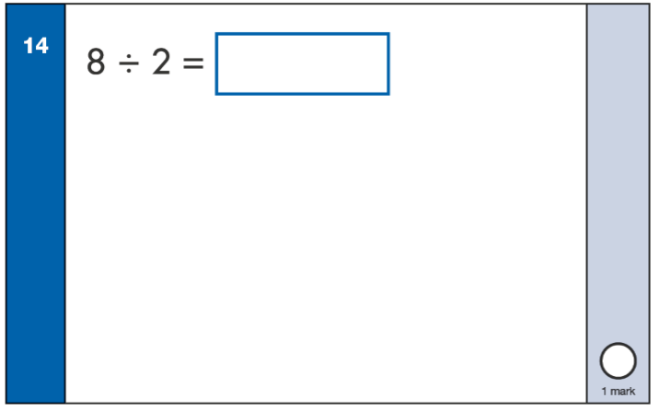
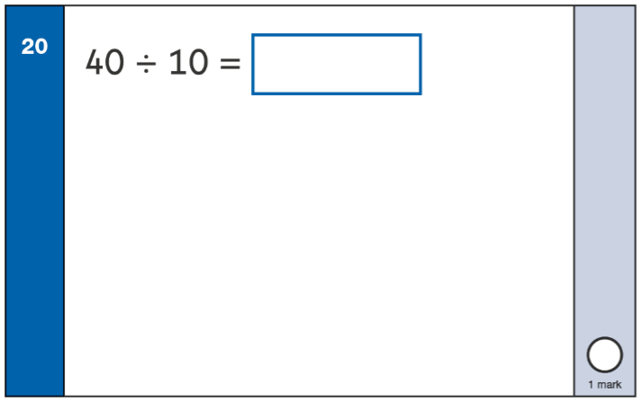
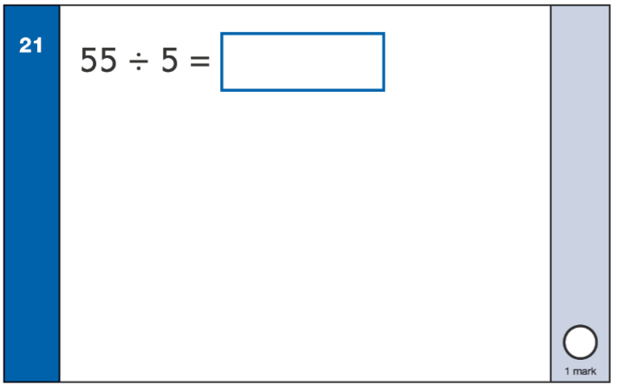
Division SATs Questions – Arithmetic Paper

Slide 19
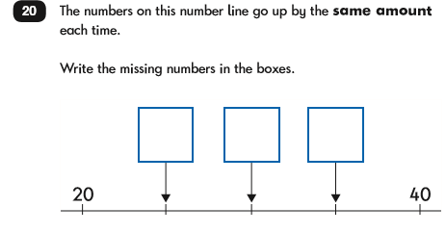
SATs Questions – Reasoning Paper

Slide 20
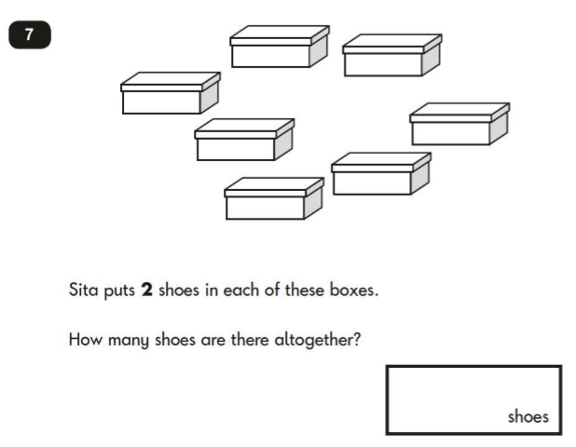
Multiplication SATs Questions – Reasoning Paper

Slide 21
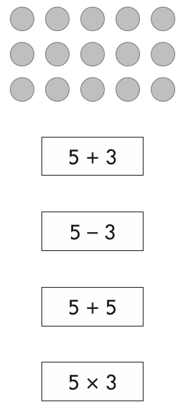
Multiplication SATs Questions – Reasoning Paper

Slide 22
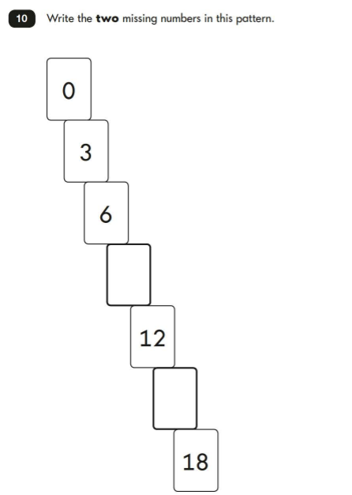
Multiplication SATs Questions – Reasoning Paper Greater Depth

Slide 23
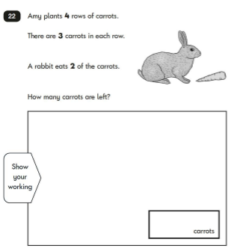
Multiplication SATs Questions – Reasoning Paper Greater Depth

Slide 24
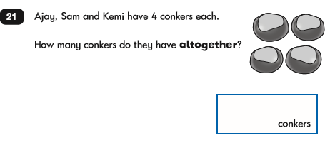
Multiplication SATs Questions – Reasoning Paper Greater Depth

Slide 25
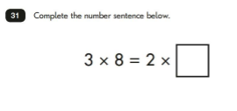
Multiplication SATs Questions – Reasoning Paper Greater Depth

Slide 26
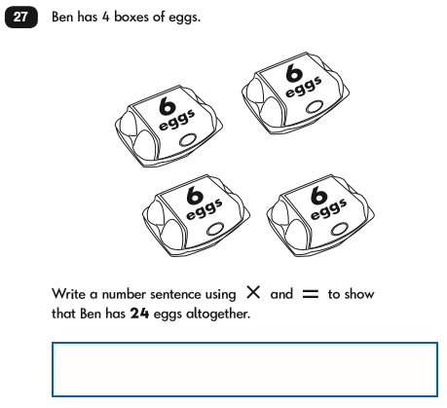
Multiplication SATs Questions – Reasoning Paper Greater Depth

Slide 27
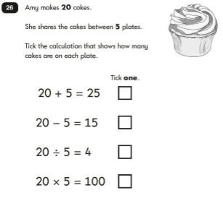
Division SATs Questions – Reasoning Paper

Slide 28
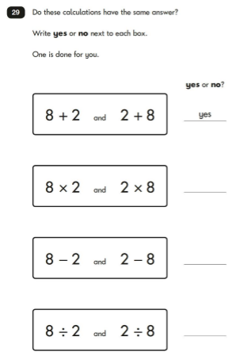
Division SATs Questions – Reasoning Paper

Slide 29
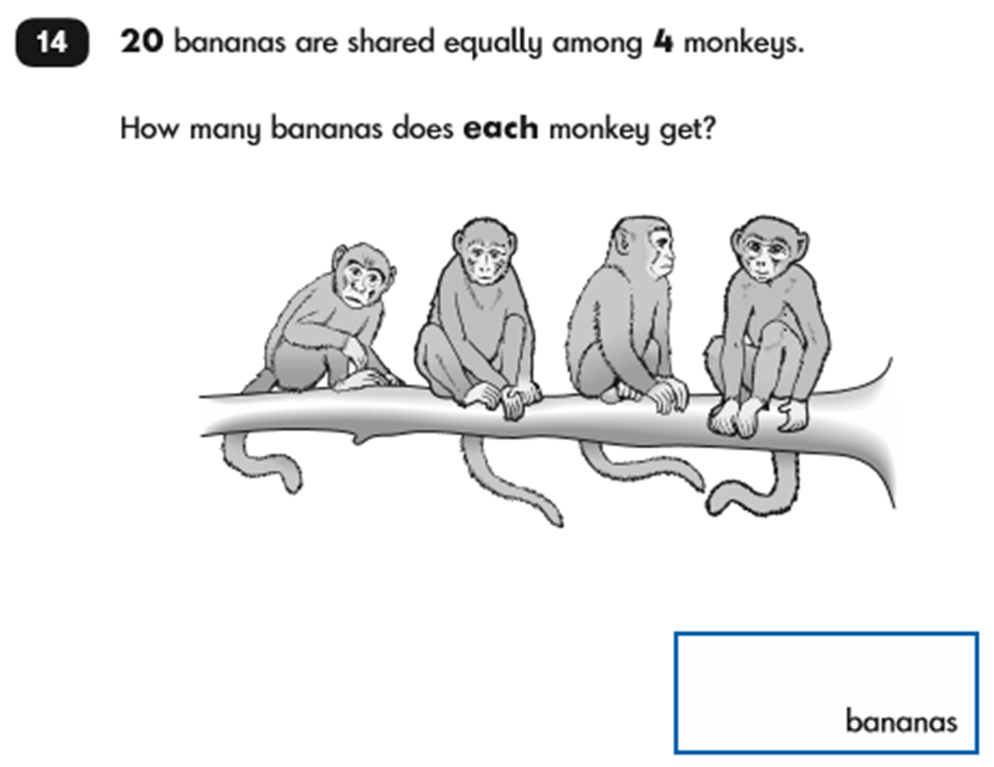
Division SATs Questions – Reasoning Paper

