Slide 1
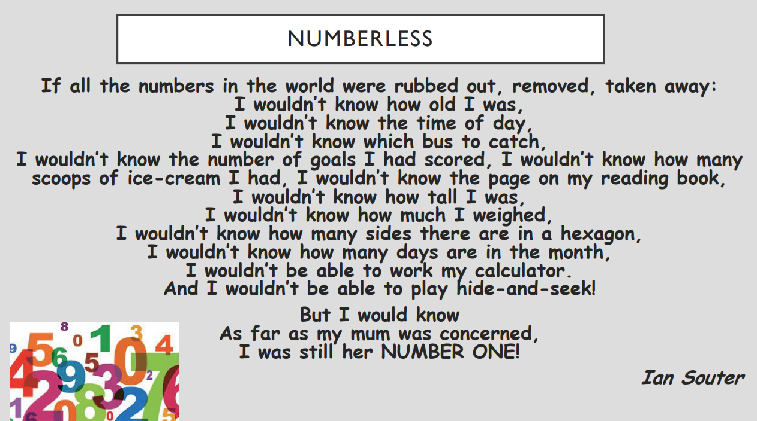

Slide 2



Slide 3
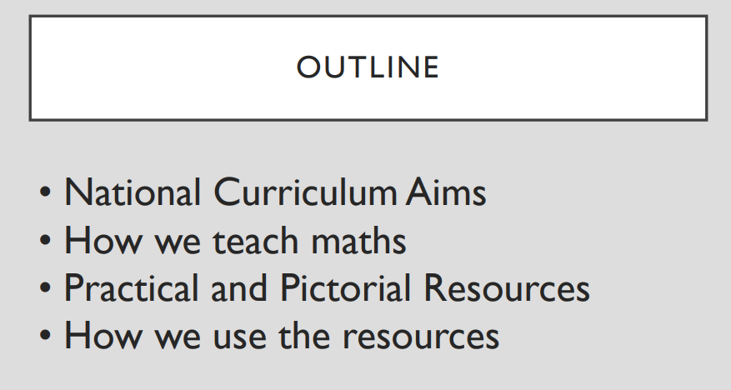

Slide 4
• What is your experience of maths at school? Positive / Negative?
• If children hear ‘I can’t do maths’ from parents, teachers, friends
they begin to believe it isn’t important
• People become less embarrassed about maths skills as it is
acceptable to be ‘rubbish at maths’- mistakes are just another learning opportunity!
• We all need to be positive role models about maths so that our
children see that it is a subject where they can succeed.

Slide 5
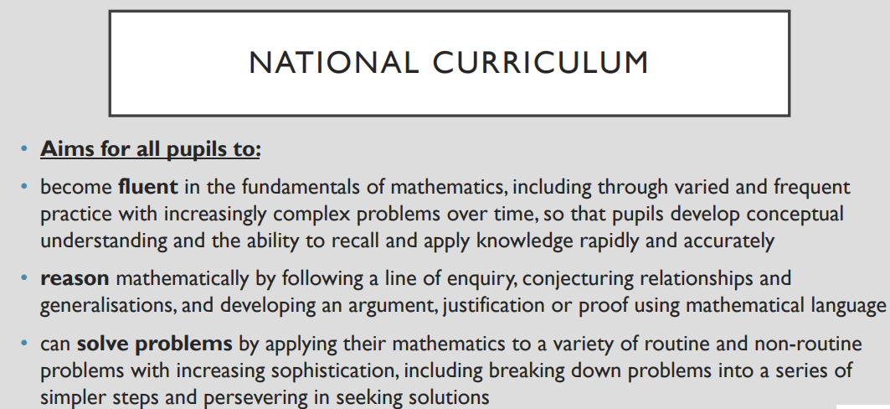

Slide 6
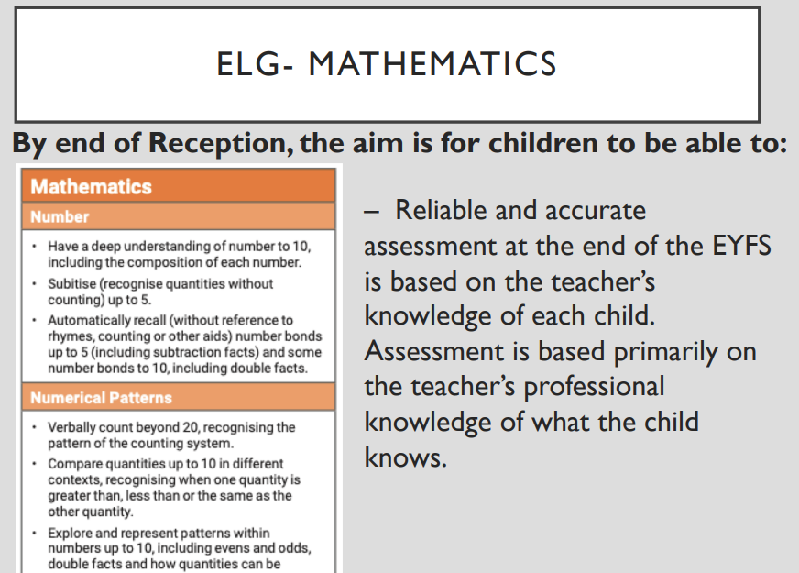

Slide 7
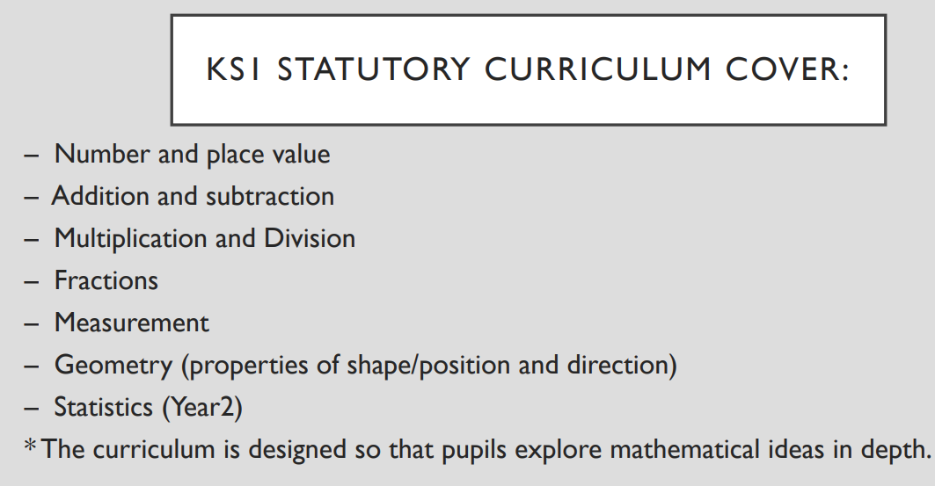

Slide 8
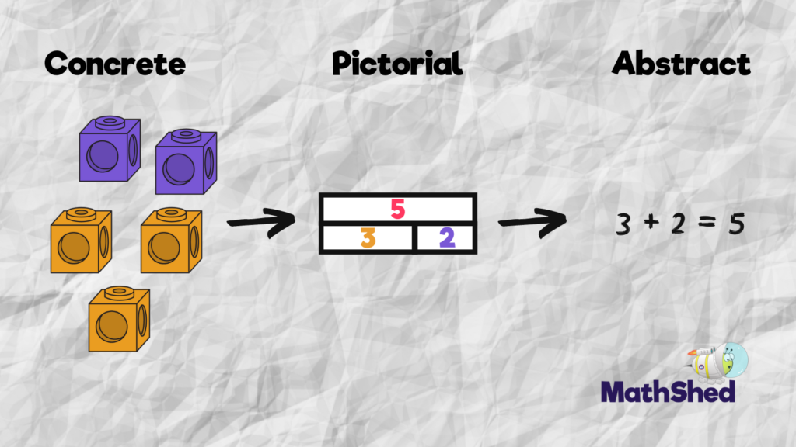

Slide 9
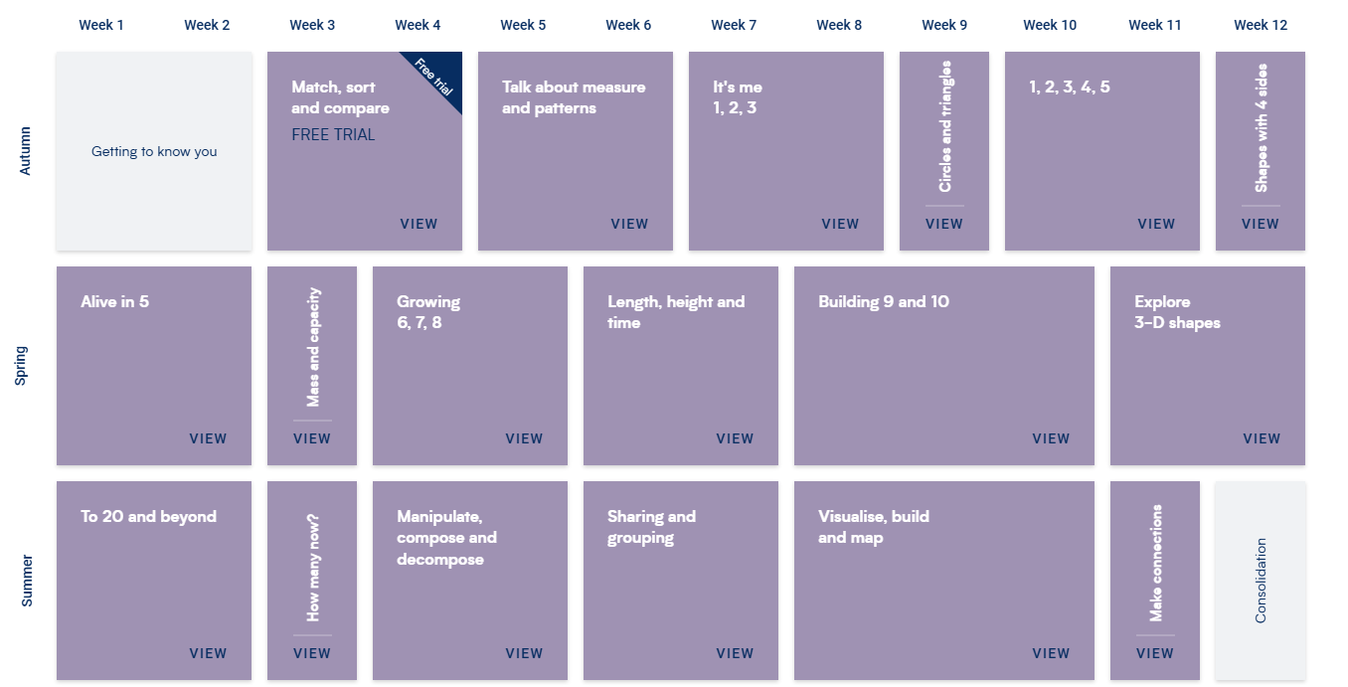
Reception: White Rose Maths

Slide 10
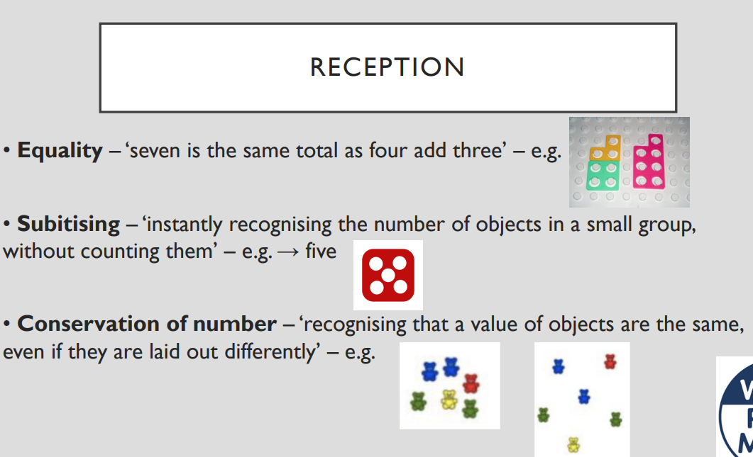


Slide 11
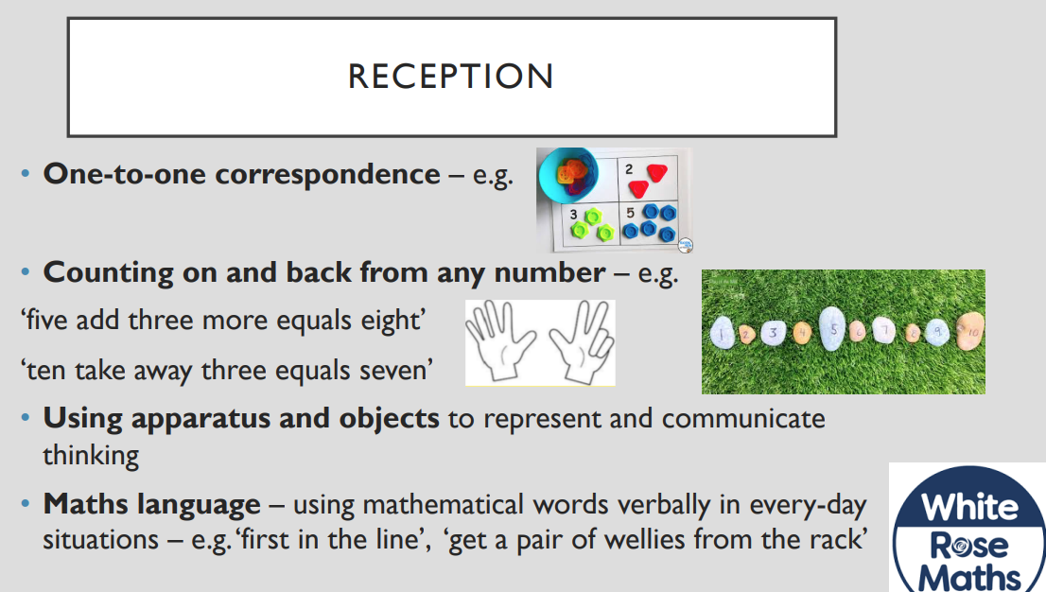

Slide 12
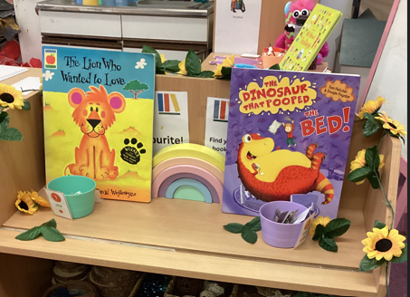
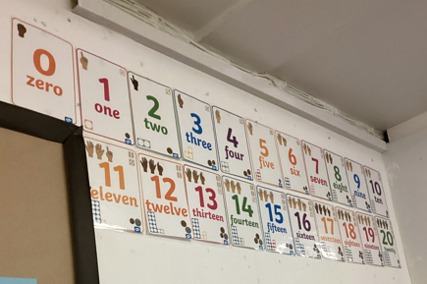
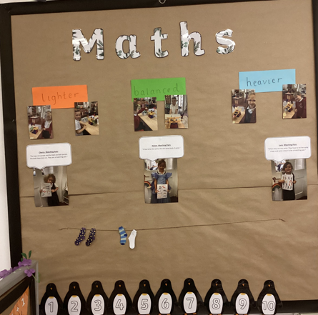
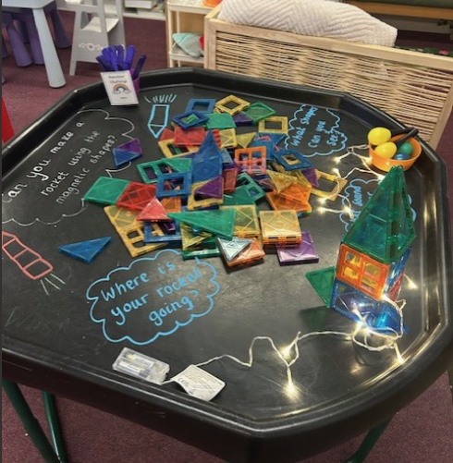
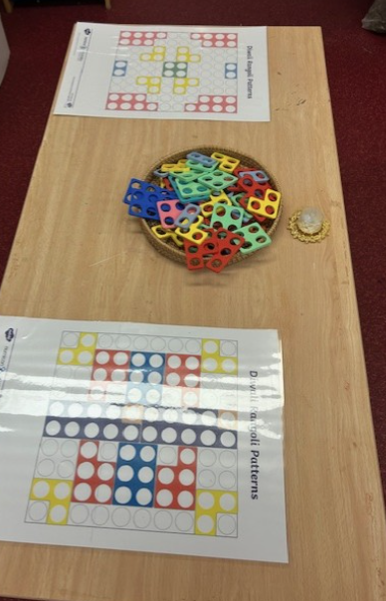
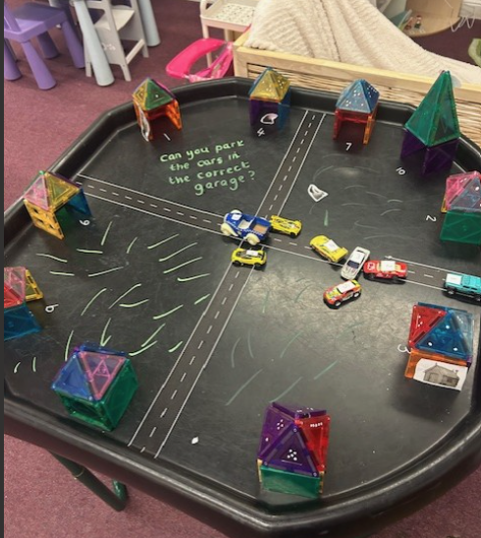
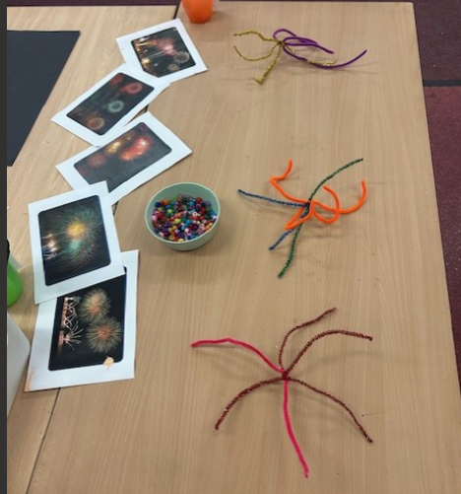
Maths in Spring Class

Slide 13
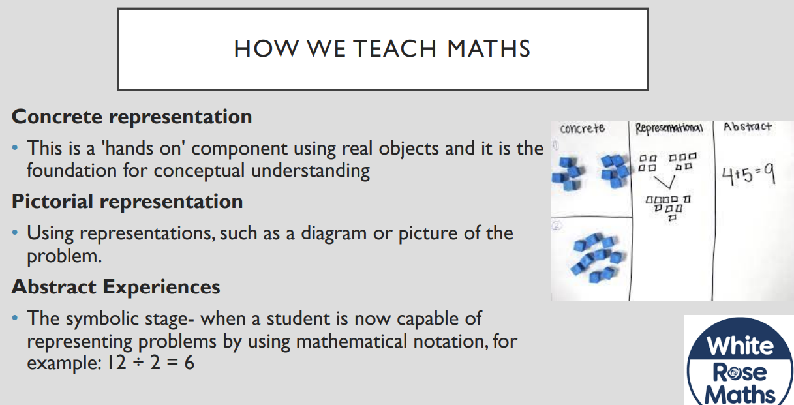
Multiplication

Slide 14

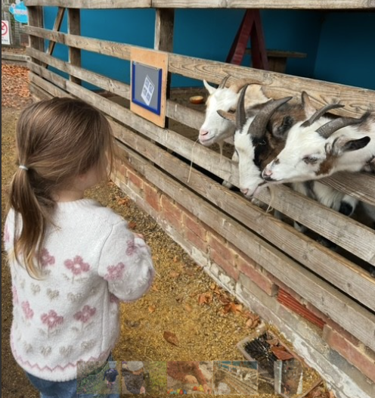
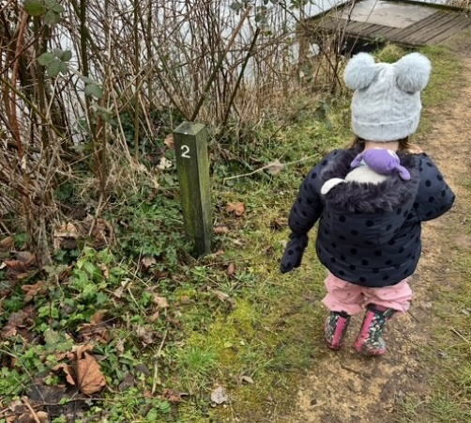


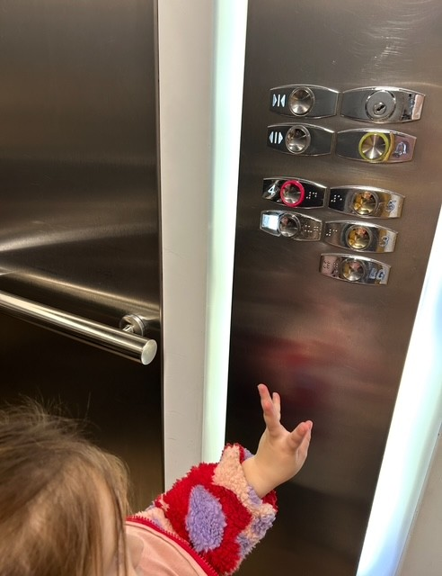
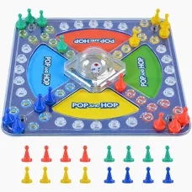
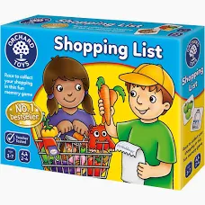

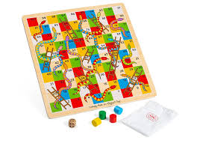
Maths at home
In the Environment
Books
Games

Slide 15
Useful Websites
Reception:
https://whiteroseeducation.com/
https://www.bbc.co.uk/bitesize/articles/zdjkjfr#zk4wp9q
https://www.bbc.co.uk/iplayer/episodes/b0bb6kn8/kit-pup
https://www.topmarks.co.uk/

