Slide 1
Multiplication in KS2
Maths Information Evening- 19th January 2026

Slide 2
Times tables- Expectations
By the end of Year 3:
- 3’s, 4’s and 8 times tables
- 2’s, 5’s and 10 times tables (Year 2 expectation)
By the end of Year 4:
- all their times tables up to 12
- The accompanying division facts e.g. if we know 6x6 is 36, then we know 36 divided by 6 is 6

Slide 3
Multiplication Tables Check (MTC)
Statutory for all Year 4 pupils in England
Online, on screen assessment
Checks ability to fluently recall times tables up to 12x12
25 questions on times tables 2 to 12
6 seconds to answer each question
https://www.timestables.co.uk/

Slide 4
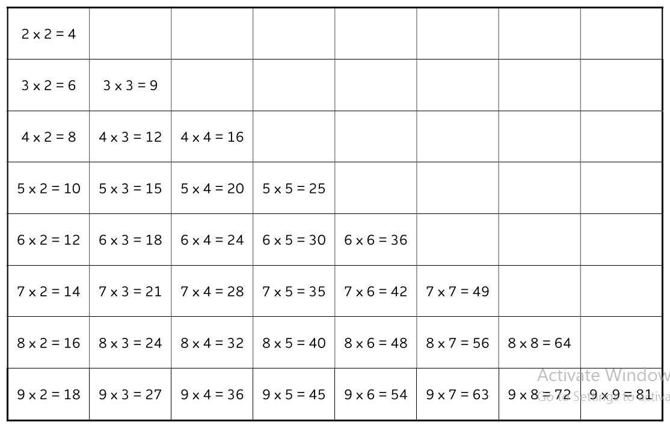
How we learn times tables in school:
Number Sense
36 essential facts
Commutativity
Arrays
Repetition

Slide 5
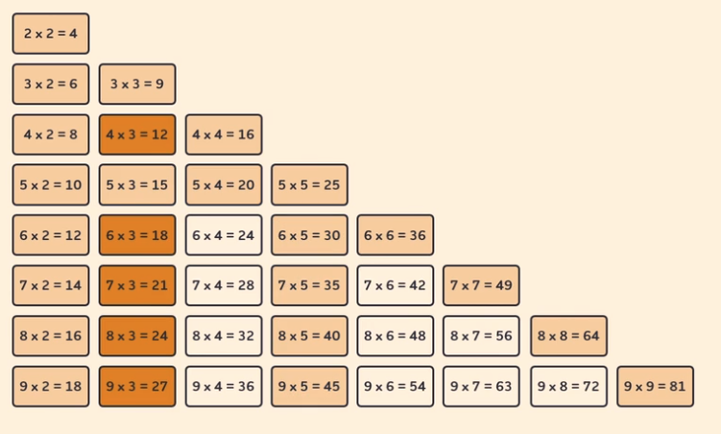
What we have covered so far…
26 facts learnt
5 new facts

Slide 6
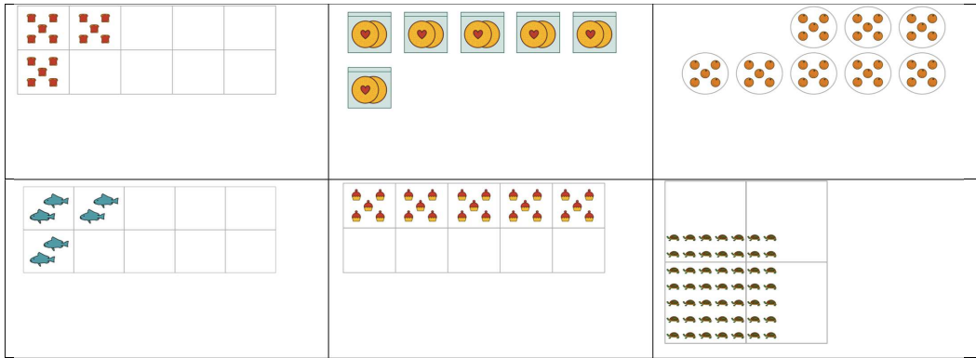
Arrays and Commutativity
………….. groups of ……………

Slide 7
What you can do at home…
Times table songs and games
Rhymes e.g. I ate and I ate till I was sick on the floor, 8x8 is 64.
Practice, practice, practice!

Slide 8
What you can do at home…
https://www.timestables.co.uk/
Good preparation for the Multiplication Tables Check completed at the end of Year 4.
https://sign-in.mathletics.com/
Times tables games
https://www.bbc.co.uk/bitesize/articles/z97rdnb#zprhvj6
Times table games and songs

Slide 9
Next steps
Grid Method
Short Multiplication

Slide 10
How would we solve this using grid method?
3 x 123 =
Notes:
Model on flipchart. Take whiteboards in to have a go.

Slide 11
How would we solve this using short multiplication?
3 x 123 =

